Slide 1

CSC-362 Computer Networks Week-6 Lecture-11-12
Prepared by:
Mr. Attique Ur Rehman

Slide 2
Instructor Contact Details
Name: Mr. Attique Ur Rehman
Course Instructor: CSC362- Computer Networks
Credit Hours: (3+1)=4
Office Location: 2nd Floor Computer Science Faculty Office: 41-C
Email: attique.rehman@lgu.edu.pk
Visiting Hours: Wednesday (11:30 am -1:00 pm)

Slide 3
Course Material
Reference books
Many textbooks on Networking may be consulted
Research papers!
RFCs and Internet drafts
Related to TCP/IP suite and other protocols
Web resources
Tutorials, white papers, reports, etc.

Slide 4
Text Book
Computer Networks: A Systems Approach by Larry L. Peterson and Bruce S. Davies.
Third Edition [2003], Morgan Kaufmann Publishers, San Mateo, California, USA
Computer Networks by Andrew S. Tanenbaum
Fifth Edition
Data Communication and Computer Networks, by Behrouz A. Forouzan
5th Edition
Data and Computer Communications by William Stallings
10th Edition
Computer Networking: A Top-Down Approach Featuring the Internet by James F. Kurose and Keith W. Ross
6th edition

Slide 5
What we know
Elements of networks: nodes and links
Building a packet abstraction on a point-to-point link
transmission methods and challenges
limiting factors on data rates
defining units of communication data
detecting transmission errors
simulating an error-free channel
Sliding window mechanism

Slide 6
OSI
Application
Presentation
Session
LOGICAL LINK sublayer
Transport
Framing
Error control
Flow control
Network
Data Link
Physical
MEDIA ACCESS sublayer
Transmission/reception of frames

Slide 7
The Medium Access Sublayer
THE CHANNEL ALLOCATION PROBLEM
MULTIPLE ACCESS PROTOCOLS
IEEE STANDARD 802 FOR LANs

Slide 8
The Channel Allocation Problem
How to allocate a single broadcast channel among competing users?
Static
FDM /TDM (Frequency/Time Division Multiplexing)
FDM : Radio/TV broadcasts
TDM : POTS (Plain Old Telephone System)
GSM uses both (Global System for Mobile Communications)
Wasteful of bandwidth
Dynamic
Pure/ Slotted ALOHA
Carrier Sense Multiple Access (CSMA) Protocols
CSMA, CSMA/CD, CSMA/CA
Collision free protocols

Slide 9
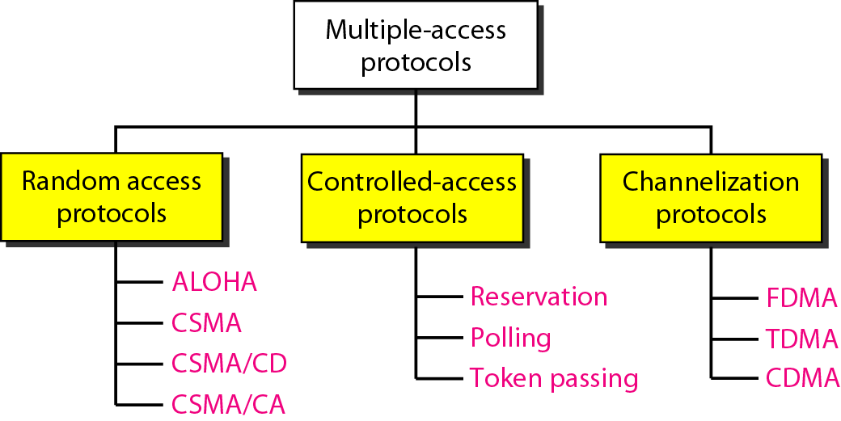
Multiple-access protocols

Slide 10
Random Access
In random access or contention methods
No station is superior to another station and none is assigned the control over another.
No station permits, or does not permit, another station to send.
At each instance, a station that has data to send uses a procedure defined by the protocol to make a decision on whether or not to send.

Slide 11
Random Access
Pure ALOHA
Slotted ALOHA
CSMA
CSMA/CD
CSMA/CA

Slide 12
Basic Assumption for Dynamic Channel Allocation
Station Model
Single Channel Assumption
Collision Assumption
Continuous Time or Slotted Time
Carrier Sense or No carrier Sense
Note: word ” carrier” in this sense refer to as electrical signal on the cable

Slide 13
Pure ALOHA
1970, Norman Abramson, U. of Hawaii
Users transmit whenever they have data
When collision occurs, wait for a random amount of time and send again
Retransmission is required for collisions (e.g. LLC sublayer or TCP)
Hosts wait a timeout for an ACK.
If no ACK by timeout, then wait a randomly selected delay to avoid repeated collisions, then retransmit
Probability of collision increases with number of transmitting nodes
Assuming Poisson arrivals, maximum throughput achieved at 18% load

Slide 14
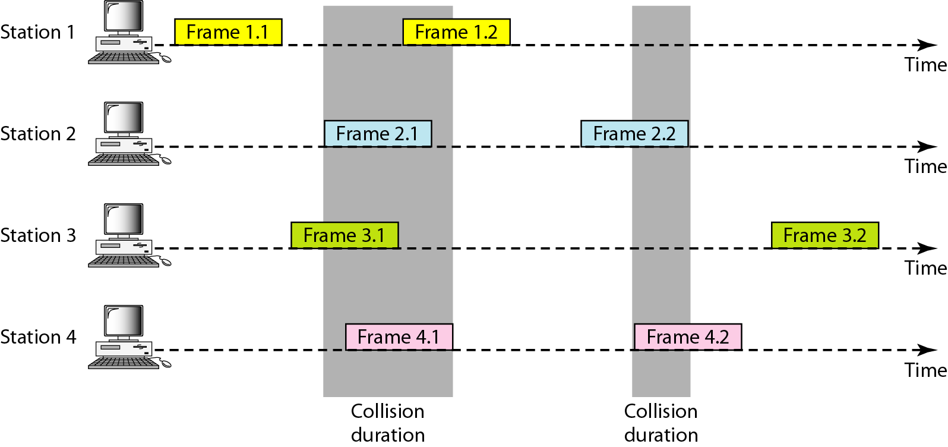
Pure ALOHA

Slide 15
Pure ALOHA

Slide 16
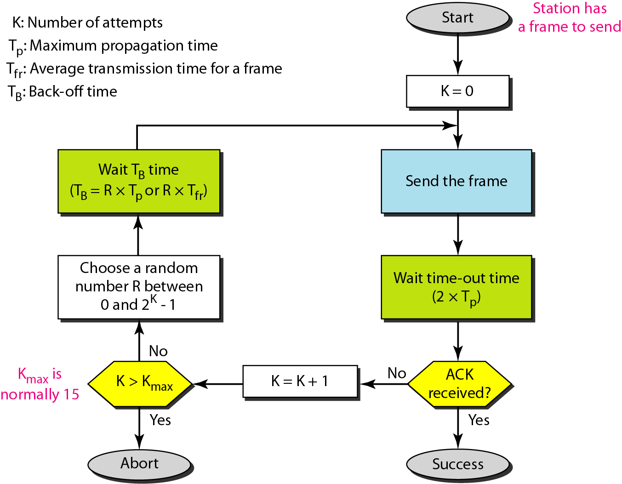
Pure ALOHA

Slide 17
Example 1
The stations on a wireless ALOHA network are a maximum of 600 km apart. If we assume that signals propagate at 3 × 10⁸ m/s, we find
Tp = (600 × 10³ ) / (3 × 10⁸ ) = 2 ms.
Now we can find the value of T_{B} for different values of K .
a. For K = 1, the range is {0, 1}. The station needs to| generate a random number with a value of 0 or 1. This means that T_{B} is either 0 ms (0 × 2) or 2 ms (1 × 2), based on the outcome of the random variable.
For K = 2, the range is {0, 1, 2, 3}. This means that T_{B} can be 0, 2, 4, or 6 ms, based on the outcome of the random variable.
c. For K = 3, the range is {0, 1, 2, 3, 4, 5, 6, 7}. This means that T_{B} can be 0, 2, 4, . . . , 14 ms, based on the outcome of the random variable.
d. We need to mention that if K > 10, it is normally set to 10.

Slide 18
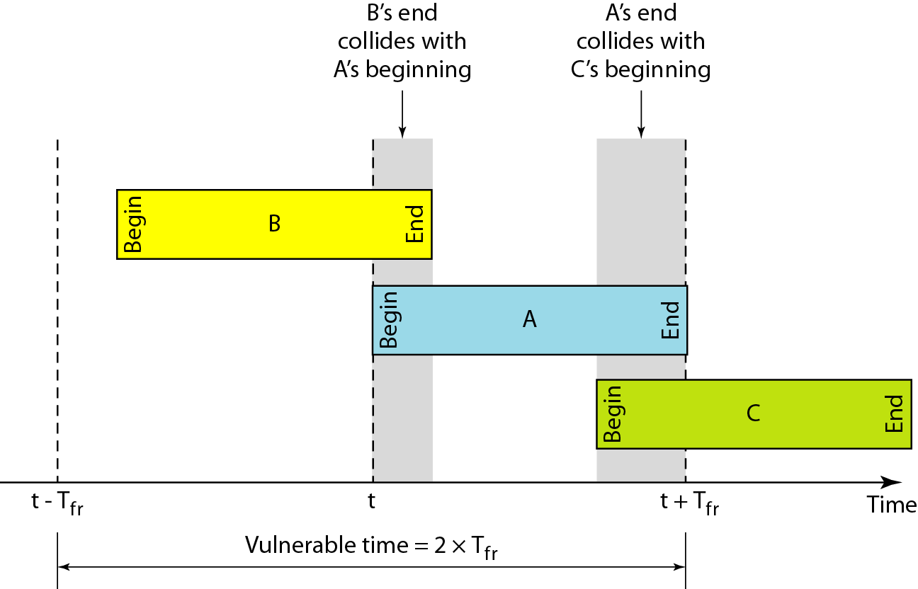
Vulnerable Time in Pure ALOHA

Slide 19
Example 2
A pure ALOHA network transmits 200-bit frames on a shared channel of 200 kbps. What is the requirement to make this frame collision-free?
Solution: Average frame transmission time T_{fr} is 200 bits/200 kbps or 1 ms. The vulnerable time is 2 × 1 ms = 2 ms. This means no station should send later than 1 ms before this station starts transmission and no station should start sending during the one 1-ms period that this station is sending.

Slide 20
Pure ALOHA – Performance Analysis
The throughput for pure ALOHA is S = G × e ^{−2G} .
The maximum throughput
S_{max} = 0.184 when G= (1/2).

Slide 21
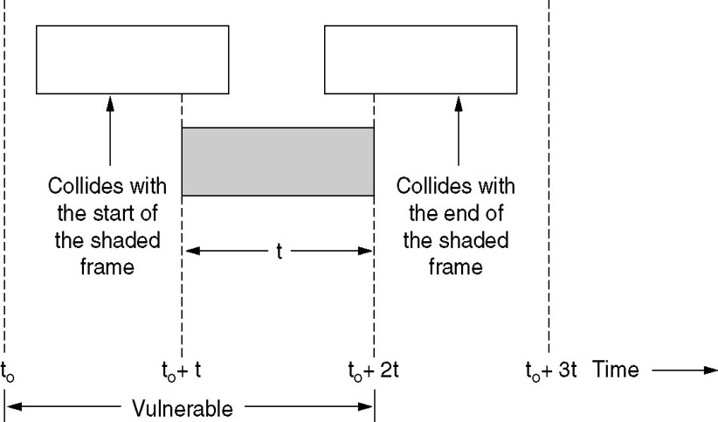
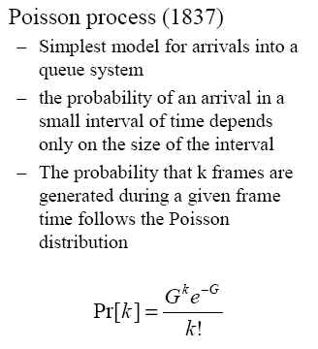
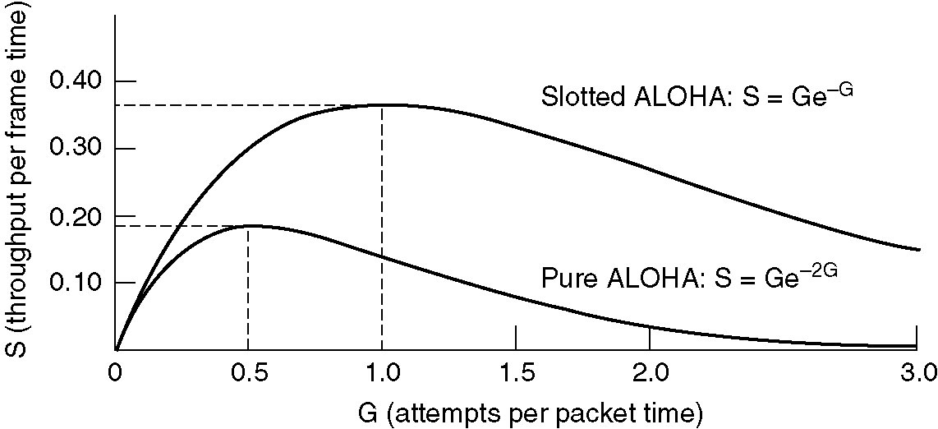
Pure ALOHA – Performance Analysis

Slide 22
Example 3
A pure ALOHA network transmits 200-bit frames on a shared channel of 200 kbps. What is the throughput if the system (all stations together) produces
a. 1000 frames per second b. 500 frames per second
c. 250 frames per second.

Slide 23
Example 3
Solution
The frame transmission time is 200/200 kbps or 1 ms.
a. If the system creates 1000 frames per second, this is 1 frame per millisecond. The load is 1. In this case S = G× e^{−2 G} or S = 0.135 (13.5 percent). This means that the throughput is 1000 × 0.135 = 135 frames. Only 135 frames out of 1000 will probably survive.
If the system creates 500 frames per second, this is (1/2) frame per millisecond. The load is (1/2). In this case S = G × e ^{−2G} or S = 0.184 (18.4 percent). This means that the throughput is 500 × 0.184 = 92 and that only 92 frames out of 500 will probably survive. Note that this is the maximum throughput case, percentagewise.
c. If the system creates 250 frames per second, this is (1/4) frame per millisecond. The load is (1/4). In this case S = G × e −^{2G} or S = 0.152 (15.2 percent). This means that the throughput is 250 × 0.152 = 38. Only 38 frames out of 250 will probably survive.

Slide 24
Slotted ALOHA
1972, Roberts
Slotted Aloha is an improvement over classical Aloha
Divide time into discrete intervals
All transmitters are synchronized to define fixed time slots
No coordination of medium access or resolution of collisions (like Aloha) Operation
Stations attempt to transmit only at the beginning of a time slot
If transmissions from two or more stations overlap, there is a collision
Retransmission is required for collisions (e.g,LLC sub-layer or TCP )
Doubles the maximum throughput
Node with new arriving packet: transmit at beginning of next slot
If collision: retransmit packet in future slots with probability p , until
successful

Slide 25
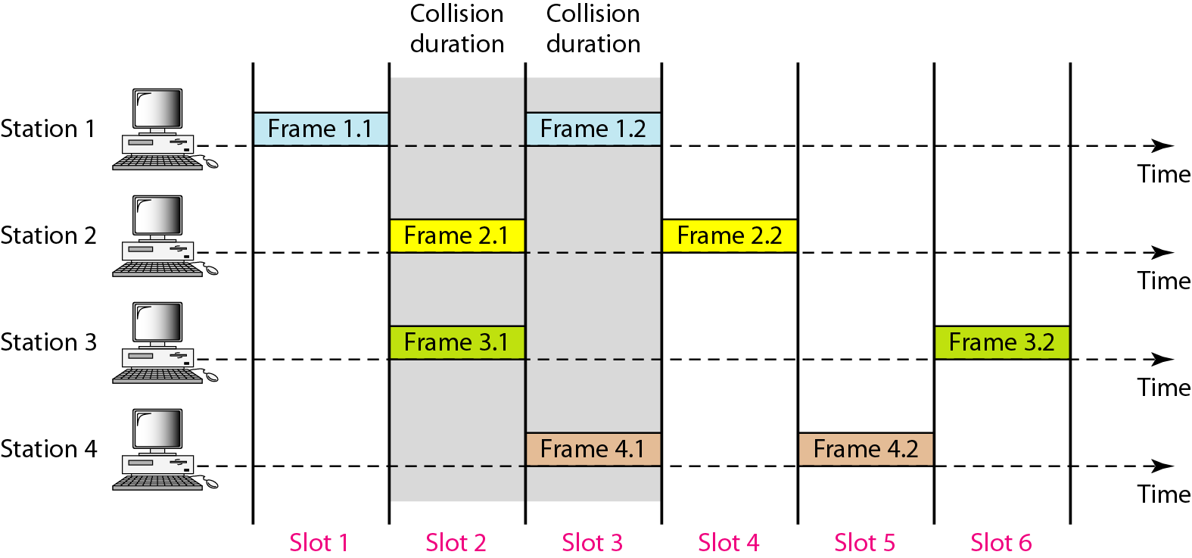
Slotted Aloha

Slide 26
Slotted ALOHA
Rather than sending a packet at any time, send along time slot boundaries Collision are confined to one time slot

Slide 27
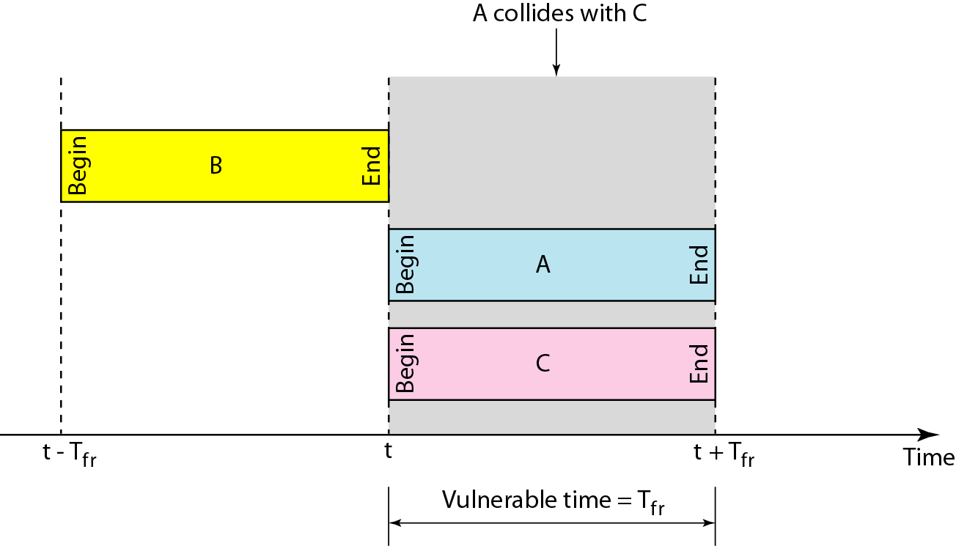
Slotted ALOHA

Slide 28
Slotted ALOHA
The throughput for slotted ALOHA is S = G × e^{−G} .
The maximum throughput S_{max} = 0.368 when G = 1.

Slide 29
Slotted ALOHA
Collision occurs if two or more stations receive new packets during the preceding time slot
One central station transmits a synchronization pulse
Assuming Poisson arrivals, maximum through achieved at 36% load
Compared to 18% for classical Aloha, where collision occurs if two or more stations receive new packets during the preceding or current “time slot”

Slide 30
Example 4
A slotted ALOHA network transmits 200-bit frames on a shared channel of 200 kbps. What is the throughput if the system (all stations together) produces
a. 1000 frames per second
b. 500 frames per second
C. 250 frames per second.

Slide 31
Example 4
Solution
The frame transmission time is 200/200 kbps or 1 ms.
a. If the system creates 1000 frames per second, this is 1 frame per millisecond. The load is 1. In this case S = G× e^{−G} or S = 0.368 (36.8 percent). This means that the throughput is 1000 × 0.0368 = 368 frames. Only 386 frames out of 1000 will probably survive.
b. If the system creates 500 frames per second, this is (1/2) frame per millisecond. The load is (1/2). In this case S = G × e^{−G} or S = 0.303 (30.3 percent). This means that the throughput is 500 × 0.0303 = 151. Only 151 frames out of 500 will probably survive.
c. If the system creates 250 frames per second, this is (1/4) frame per millisecond. The load is (1/4). In this case S = G × e ^{−G} or S = 0.195 (19.5 percent). This means that the throughput is 250 × 0.195 = 49. Only 49 frames out of 250 will probably survive.

Slide 32
Comparison Between Pure and Slotted Aloha
Slotted ALOHA is more efficient than ALOHA because when there is a collision, the wasted time is confined to one time slot
ALOHA & slotted ALOHA are inefficient because hosts don’t take into account what other hosts are doing before they transmit

Slide 33
Carrier Sense Multiple Access (CSMA)
Carrier Sense Multiple Access (CSMA) further improves Aloha by “listening before transmitting”
Can significantly reduce the probability of a collision
Operation
Node wishing to transmit data first sense the channel
A node can only transmit if the medium is sensed idle
If channel sensed busy, defer transmission
Human analogy: don’t interrupt others!
Transmissions from two or more stations can still overlap collisions can occur
Retransmission is required for collisions (e.g., LLC sublayer or TCP)

Slide 34
CSMA “Persistence”
“Persistence” deals with how CSMA responds when channel becomes idle
Station transmits with probability p
Defers transmission until the next time slot with probability 1-p
Most interesting values are p = 1 and p=0

Slide 35
CSMA – Carrier Sense Multiple Access (LAN)
• 1-persistent
– When idle, transmit a frame
– When busy, continuously sensing
– When collision, wait for a random amount of time
• Non-persistent
– When idle, transmit a frame
– When busy, wait for a random amount of time
– When collision, wait for a random amount of time then re-sense
• p-persistent
– Slotted channels
– When idle, transmit with a probability p, defers until the next slot with probability 1-p
•

Slide 36
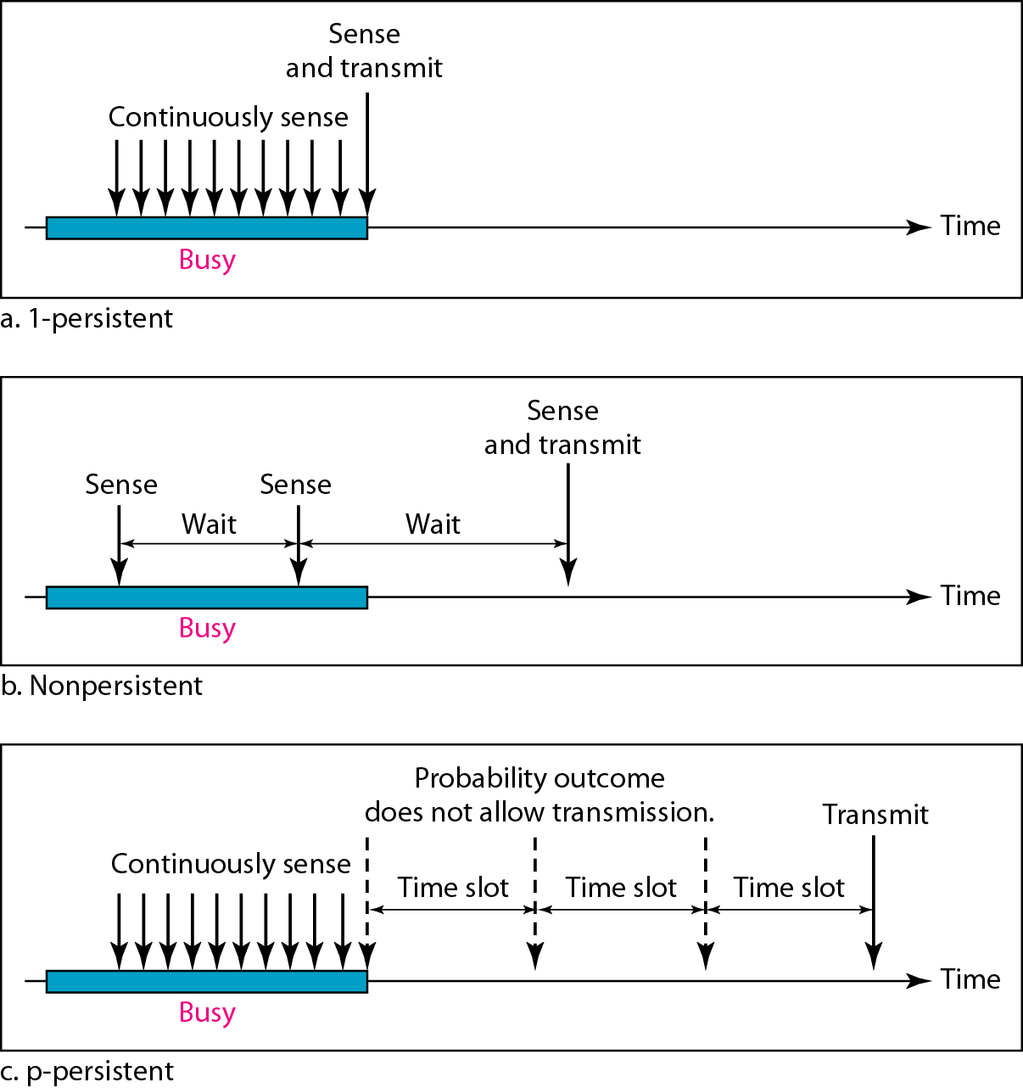
Carrier Sense Multiple Access (CSMA)

Slide 37
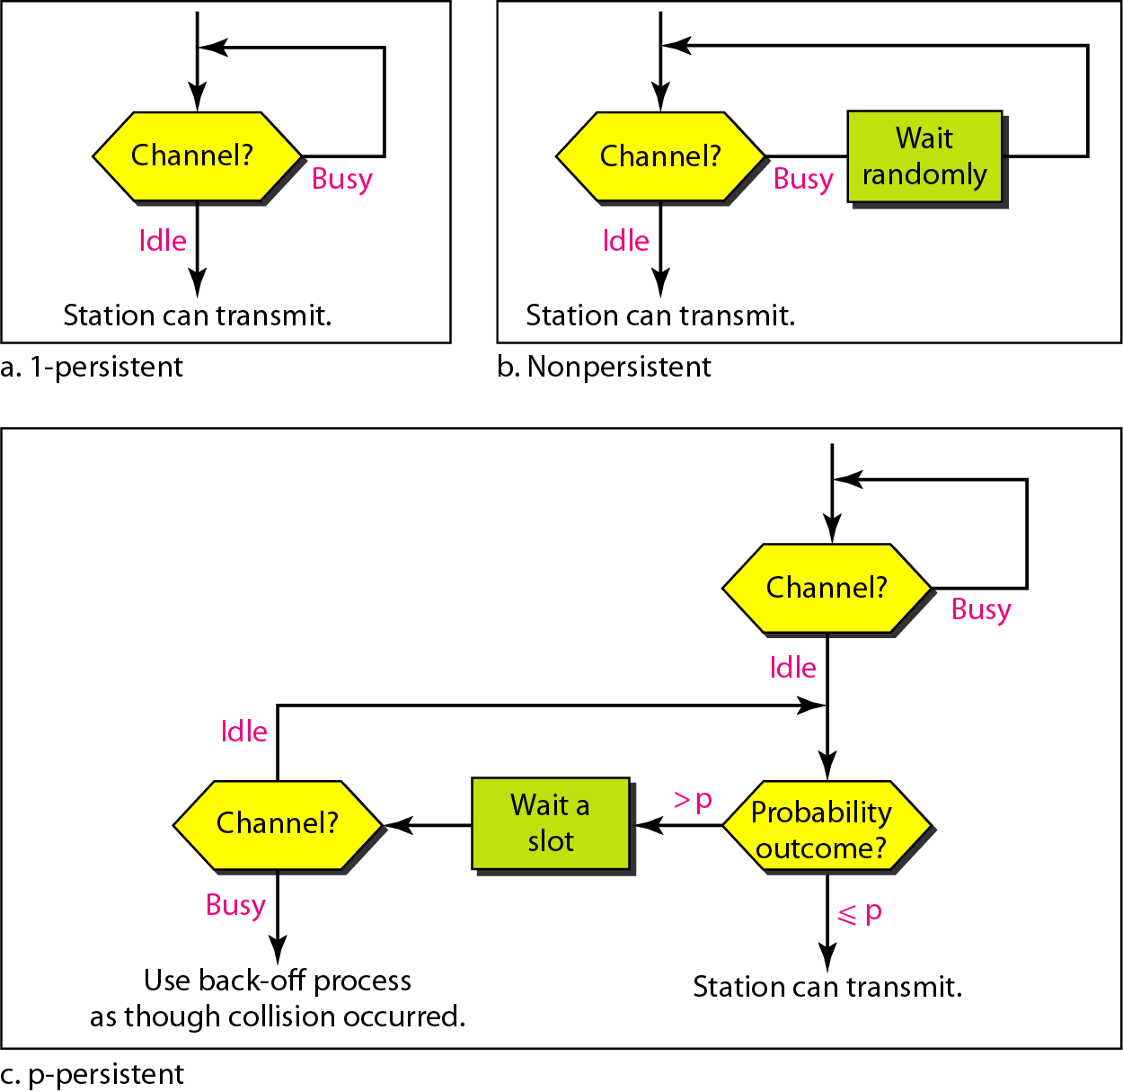
Carrier Sense Multiple Access (CSMA)

Slide 38
1-Persistent CSMA (p=1)
When idle, transmit a frame
When busy,
continuously sensing
When channel becomes free, a host transmits its packet immediately (with probability 1)
Collision Scenario
Hosts A and B are far apart (long prop. delay). A’s signal takes a long time (Propagation delay problem)
Hosts B and C transmit as soon as A finishes (Even Propagation delay is Zero)
Increased probability of collision due to two or more waiting stations transmitting at about the same time
Still , CSMA is more efficient than ALOHA variants

Slide 39
Non-persistent or 0-persistent ( p = 0)
When idle, transmit a frame
If channel goes from busy to idle, station waits a random/sleep
amount of time and then senses the medium again
Repeated until channel is sensed to be idle
As with 1-persistent CSMA, as soon as channel is idle, then send a packet
Random interval reduces collisions
Reduced probability of collision after channel goes from busy to idle
Increased probability of under-utilization of channel
1-persistent better than 0-persistent if..
Offered load is light, or
Higher throughput than 1-persistent CSMA when many sender
Penalty for a collision is small (e.g., collision detection is in use)

Slide 40
p-Persistent CSMA
Generalization of 1-persistent CSMA
Typically applied to slotted channels
Slot length is chosen as maximum propagation delay
A host senses the channel, and
If slot is idle, transmit with probability p, or defer with probability q =1-p
If next slot is idle, transmit with probability p, or defer probability q =1-p repeat ...
If channel is busy, then sense channel continuously until it becomes free, begin again

Slide 41
CSMA: Collisions Can Still Occur …
Nodes start to transmit at about the same time (under heavy load, > 1 node simultaneously sense the channel to be idle)
Detection time -- time to detect another station’s transmission is a significant performance factor

Slide 42
CSMA/CD (Collision Detection)
CSMA/CD: carrier sensing, deferral as in CSMA
Collisions detected within short time
Colliding transmissions aborted, reducing channel wastage
Collision detection:
Easy in wired LANs: measure signal strengths compare to transmitted and received signals
Difficult in wireless LANs; can be costly
Human analogy: the polite conversationalist

Slide 43
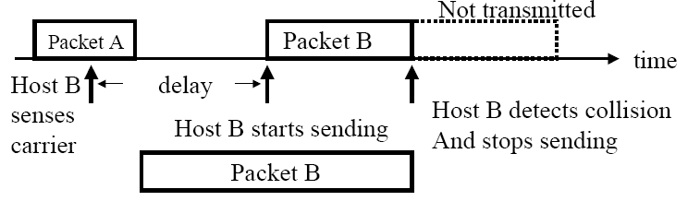
CSMA/CD
Ethernet uses CSMA/CD, i.e. CSMA with Collision Detection
“Listen-while-talk” protocol
A host listens even while it is transmitting, and if a collision is detected, stops transmitting

Slide 44
CSMA/CD
Can abort transmission sooner than end-of-packet if there is a collision
Can happen if propagation delays are long
Better efficiency than pure CSMA
CSMA/CD doesn’t require explicit acknowledgement
Unlike CSMA, which requires an ACK or timeout to detect a collision
Collision detection is built into the transmitter
When collision detected, begin retransmission

Slide 45
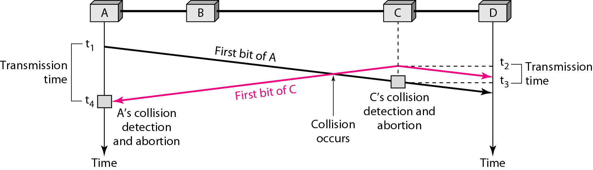
Collision of first bit in CSMA/CD

Slide 46
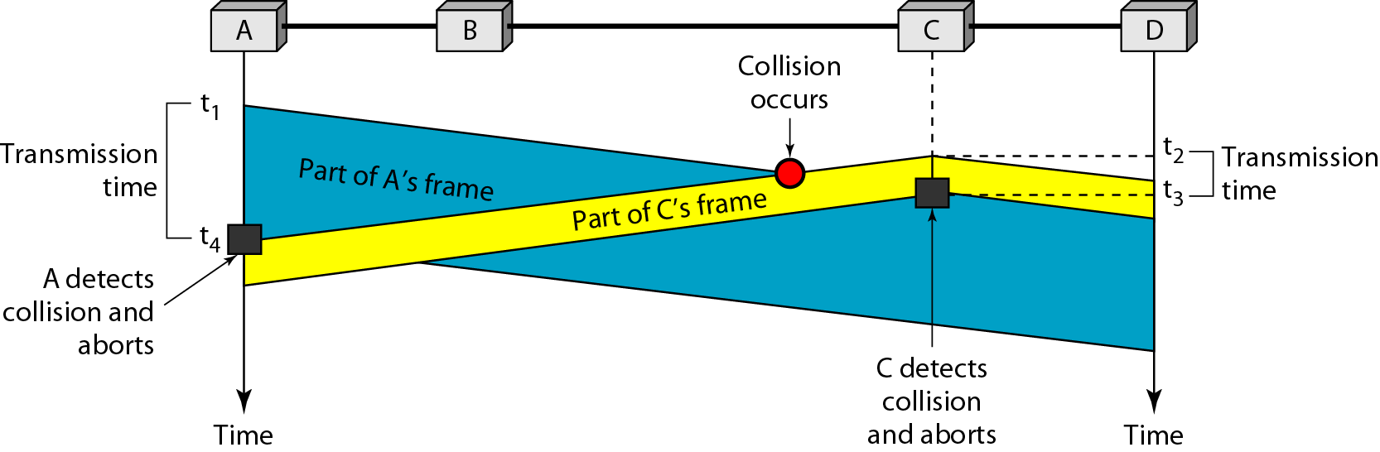
Collision and abortion in CSMA/CD

Slide 47
CSMA/CD
Exponential back-off strategy
When a collision is detected, a host waits for some randomly chosen time, then
retransmits a packet
If a second collision is detected, a host doubles the original wait time, then
retransmits the packet
Each time there is another collision, the wait time is doubled before retransmission
Variants:
At each retransmission, choose randomly from among a discrete set of values within
exponentially increasing wait time
Retransmit a finite # of times

Slide 48
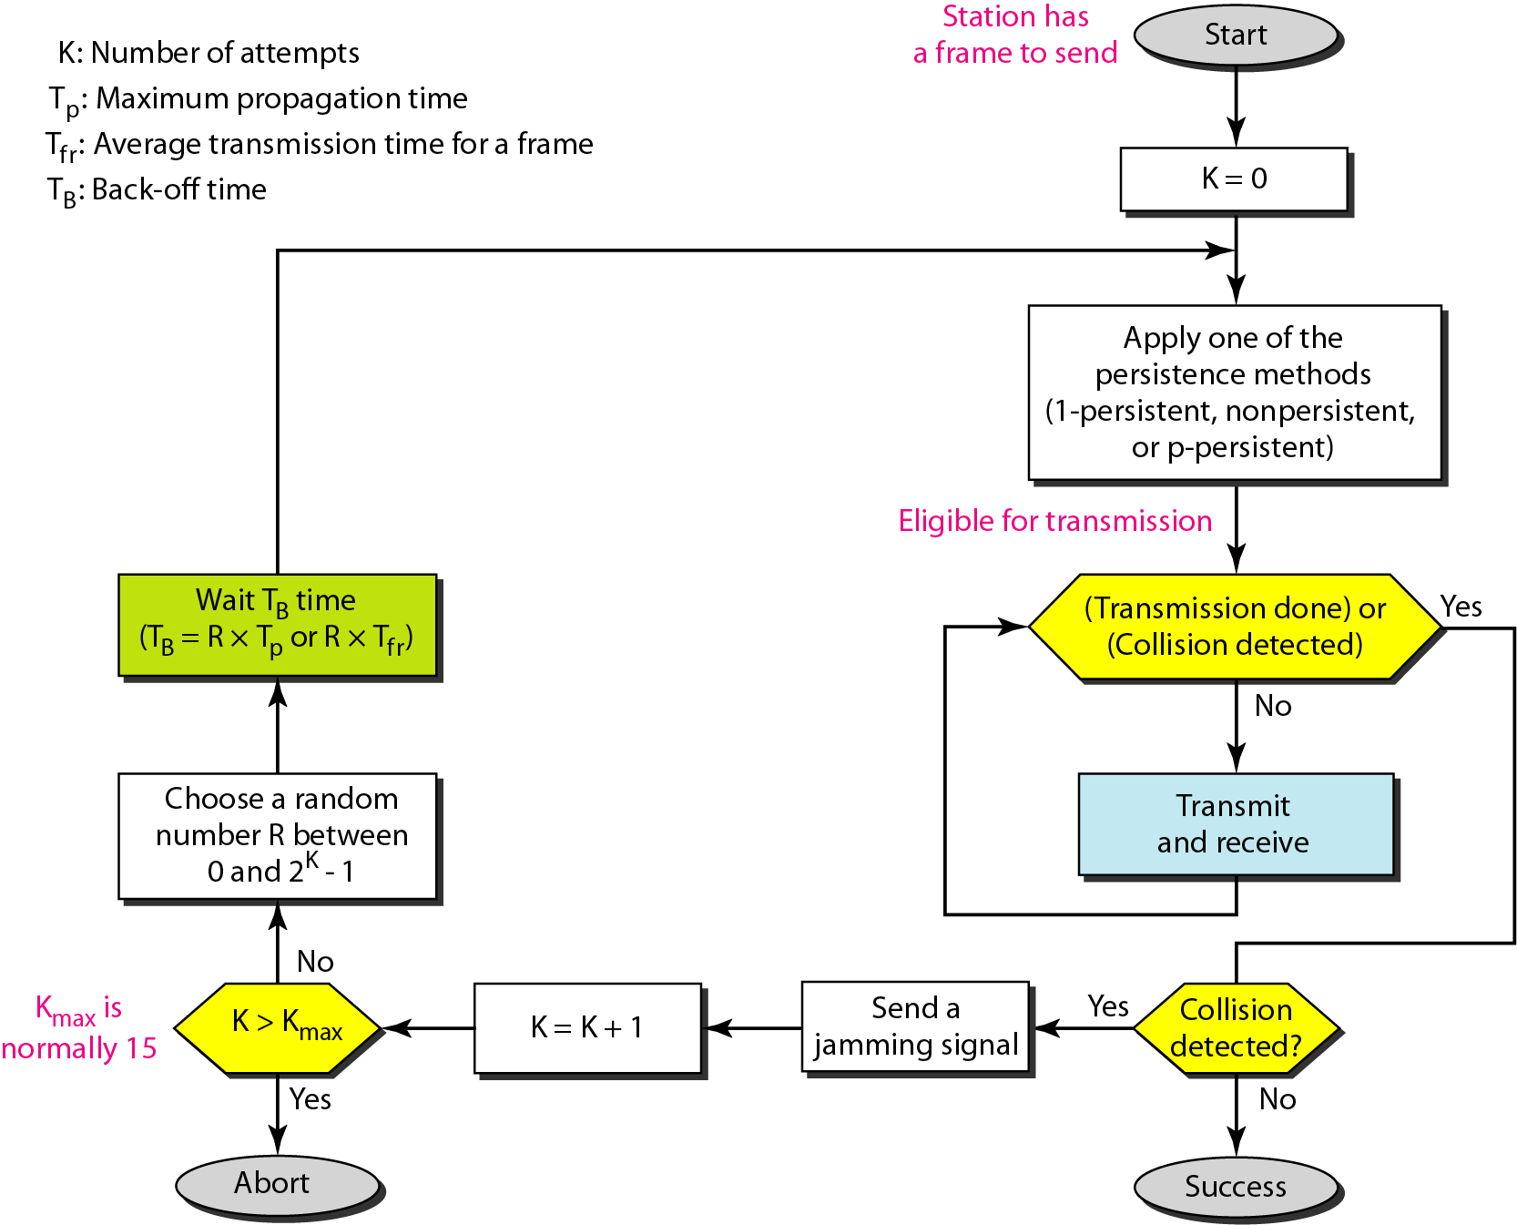
CSMA/CD

Slide 49
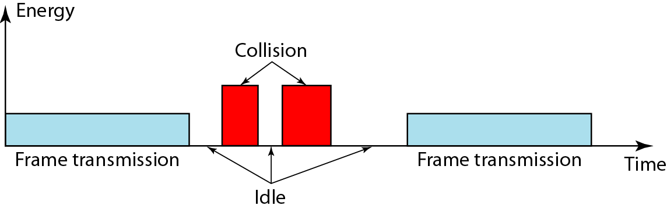
Energy Levels

Slide 50
Efficiency of CSMA/CD
• Given collision detection, instead of wasting the whole packet
transmission time (a slot), we only waste the time needed to detect collision
• In the normal case, we try approximately e times before
each successful transmission, then for each successful
transmission, which takes P/C, we waste a total of 2eT (≈5T)
seconds on collision, where T is one-way propagation delay
P: packet size, e.g. 1000 bits
C: link capacity, e.g. 10Mbps

Slide 51
Example 5
A network using CSMA/CD has a bandwidth of 10 Mbps. If the maximum propagation time (including the delays in the devices and ignoring the time needed to send a jamming signal, as we see later) is 25.6 μs, what is the minimum size of the frame?
Solution
The frame transmission time is Tfr = 2 × Tp = 51.2 μs. This means, in the worst case, a station needs to transmit for a period of 51.2 μs to detect the collision. The minimum size of the frame is 10 Mbps × 51.2 μs = 512 bits or 64 bytes. This is actually the minimum size of the frame for Standard Ethernet.

Slide 52
CSMA/CA
The CSMA/CA differ from the previous procedures in that there is no collision/ avoid the collision.
The station uses one the persistent strategy.
If it find the line idle
the station waits an IFS (inter-frame space) amount of time.
It than wait random amount of time
After that it sends the frame and set the timer.
The station waits for ACK
if ACK received before timer expires, transmission is successful.
if ACK is not received before timer expires, something is wrong.
The station increments the value of backoff parameter.
wait for backoff amount of time and re-senses again

Slide 53
CSMA/CA
In CSMA/CA, if the station finds the channel busy, it does not restart the timer of the contention window; it stops the timer and restarts it when the channel becomes idle.
In CSMA/CA, the IFS can also be used to define the priority of a station or a frame.

Slide 54
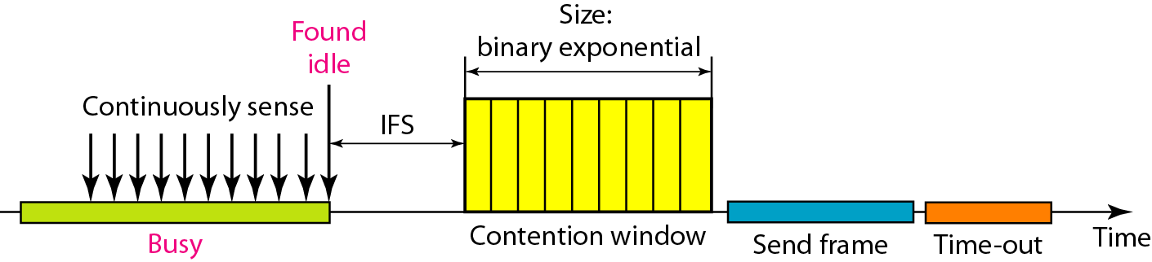
CSMA/CA

Slide 55
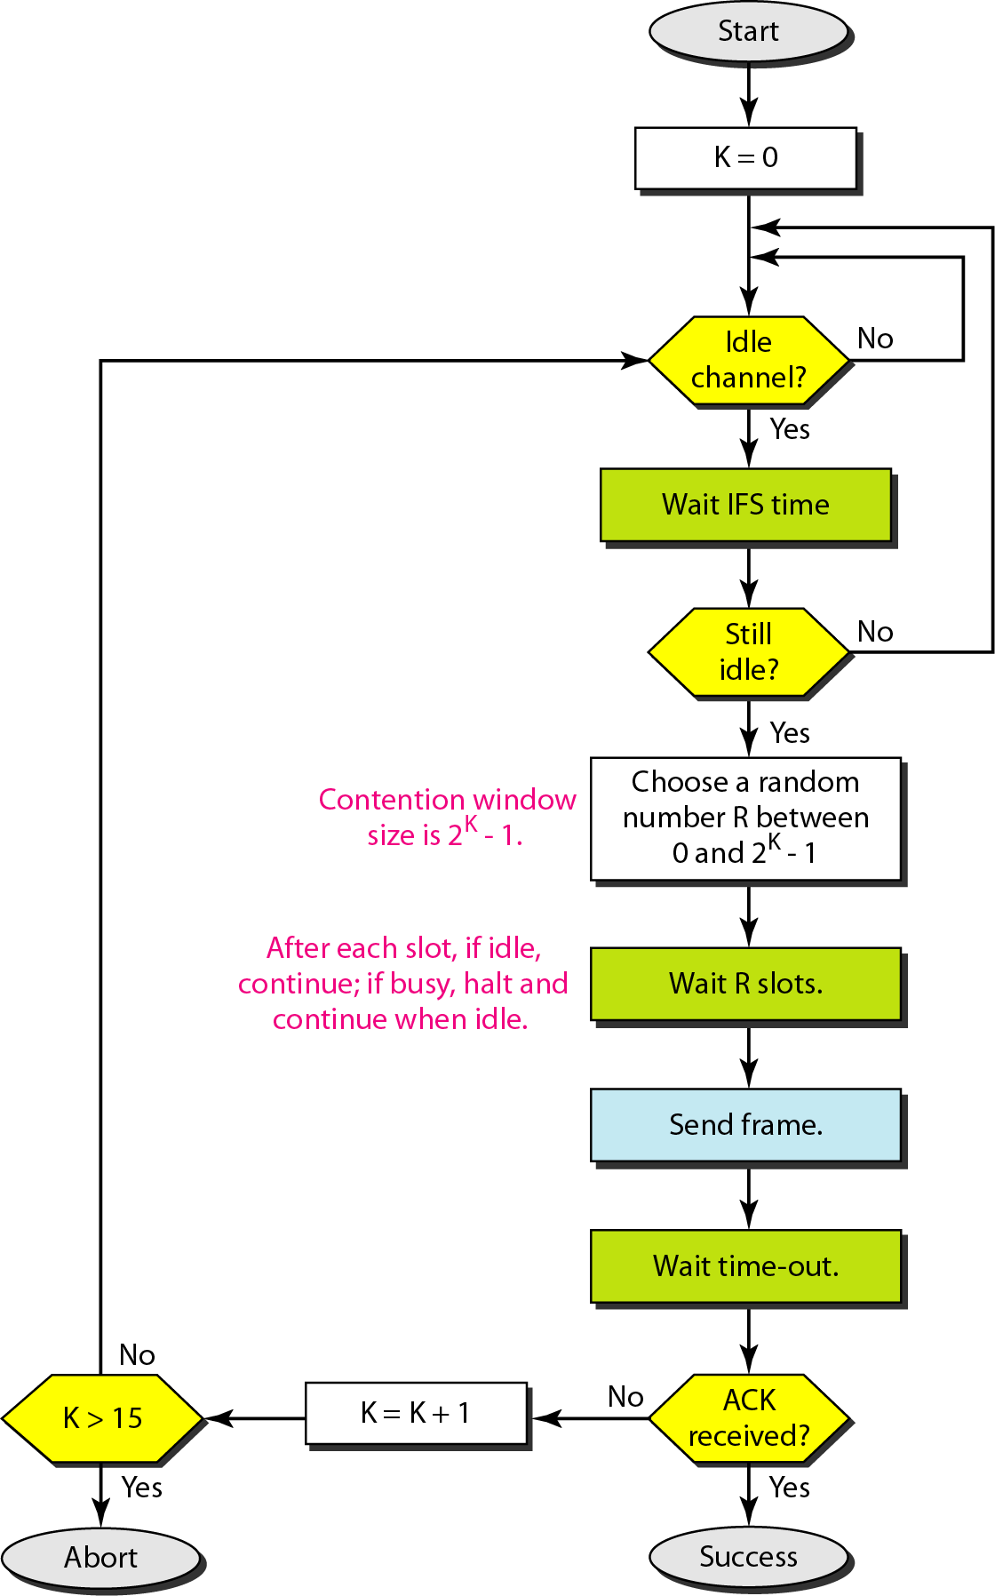
CSMA/CA

Slide 56
Reading Assignment
Chapter NO:4
Collision-Free Protocols
A Bit-Map Protocol
Binary Countdown

